Slide 1
Edge Counter Line Pairs

Slide 2
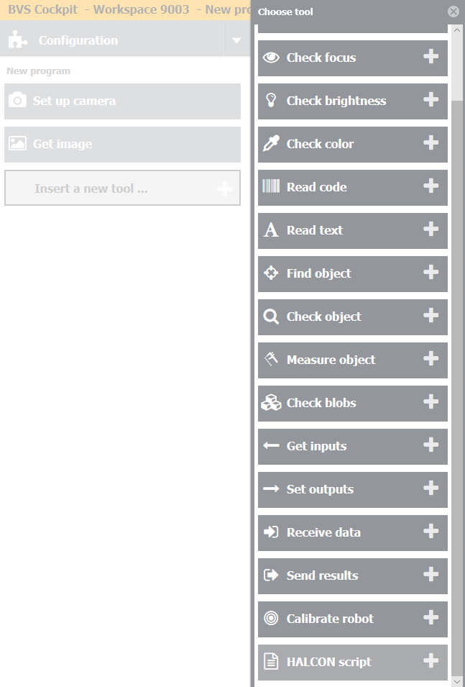
Step 1
Add new tool – Halcon Script – in your inspection program.

Slide 3
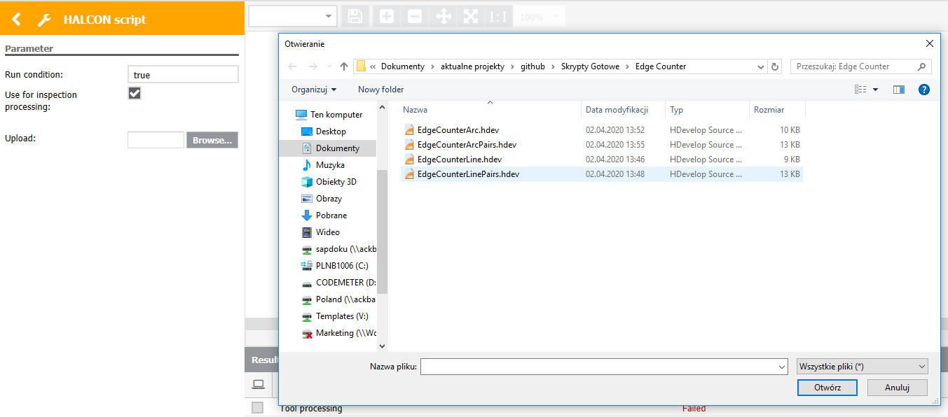
Step 2
Click „Browse” and choose „EdgeCounterLinePairs.hdev” file.

Slide 4
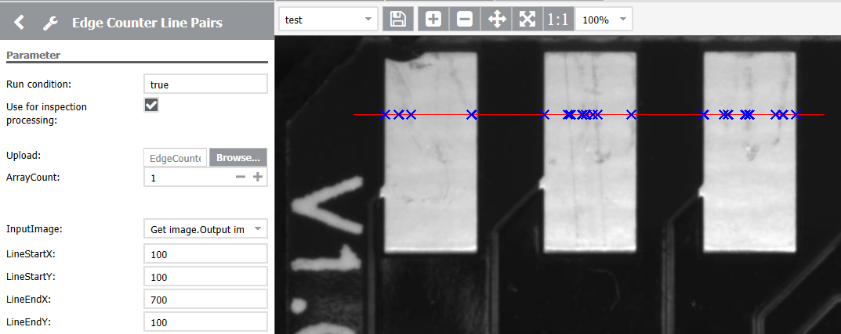
Step 3
Set the Line Start position (X and Y) and Line End position (X and Y). It will be displayed as red Line on the image.

Slide 5
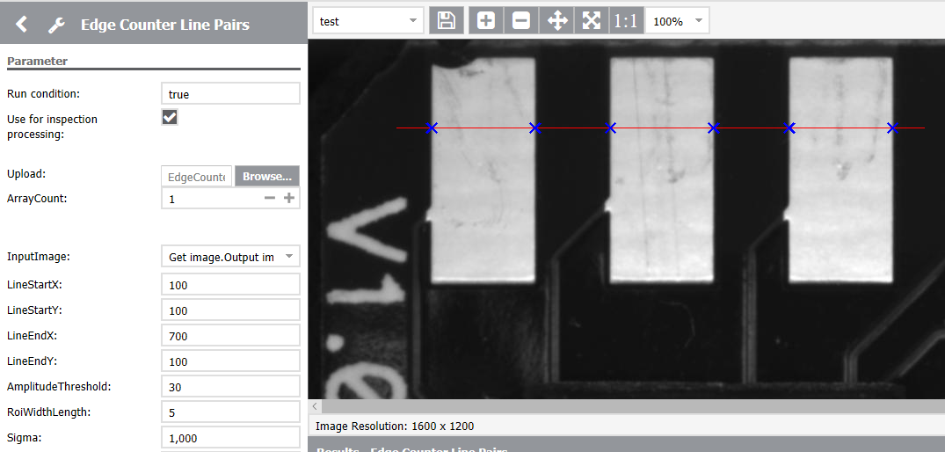
Step 3
Adjust edge parameters:
AmplitudeThreshold – minimum edge contrast
RoidWidthLength – length of the line perpendicular to the generated Line
Sigma – smoothing

Slide 6
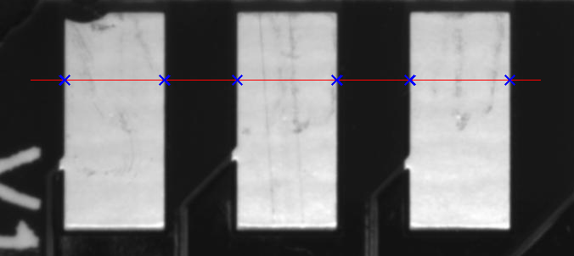
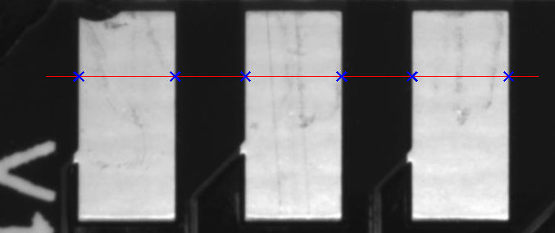
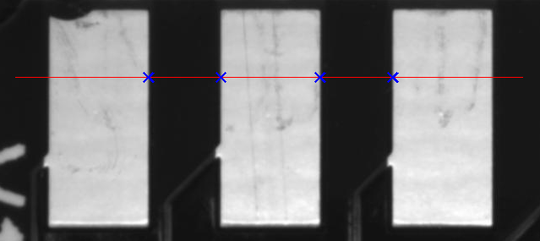
Step 4
You can also specify the edge Transition:
Positive – only light pairs will be found
Negative – only dark pairs will be found
All – pairs with both polarity will be found

Slide 7
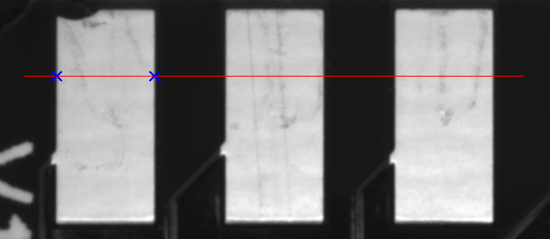
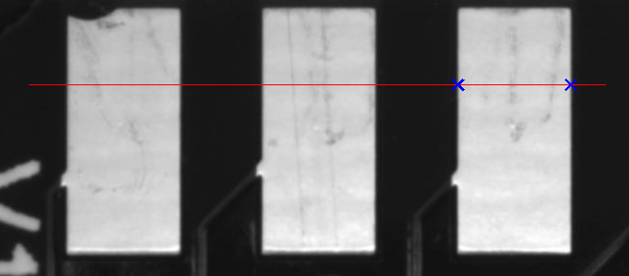
Step 5
You can also Select the edges:
First – only first pair will be found
Last – only last pair will be found
All – all of the pairs will be found

Slide 8
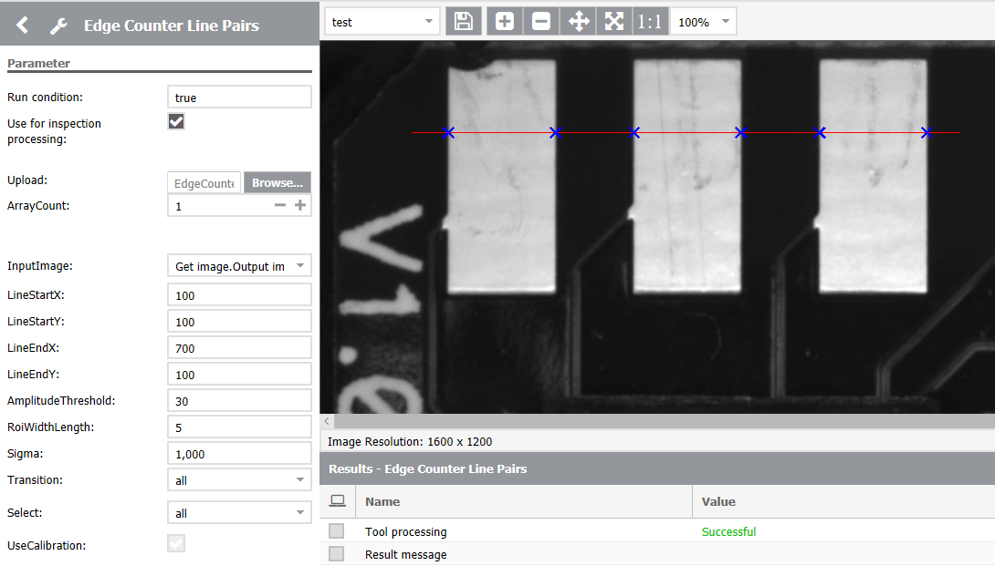
Step 6
Set the number of pairs that you want to get as an output.
Found pairs will be displayed as Crosses on the image.

Slide 9
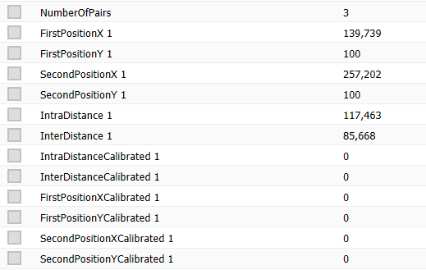
Step 7
Available output parameters:
NumberOfPairs – number of found pairs
FirstPositionX (n) – X position of the first edge of the (n) found pair
FirstPositionY (n) – Y position of the first edge of the (n) found pair
SecondPositionX (n) – X position of the second edge of the (n) found pair
SecondPositionY (n) – Y position of the second edge of the (n) found pair
IntraDistance (n) – distance between first and second edge in (n) found pair
InterDistance (n) – distance between second edge in (n) pair and first edge in (n+1) pair
FirstPositionXCalibrated (n) – X position of the first edge of the (n) found pair after calibration
FirstPositionYCalibrated (n) – Y position of the first edge of the (n) found pair after calibration
SecondPositionXCalibrated (n) – X position of the second edge of the (n) found pair after calibration
SecondPositionYCalibrated (n) – Y position of the second edge of the (n) found pair after calibration
IntraDistanceCalibrated (n) – distance between first and second edge in (n) found pair after calibration
InterDistanceCalibrated (n) – distance between second edge in (n) pair and first edge in (n+1) pair after calibration

Slide 10

Step 8
Calibrated output parameters have proper values if the UseCalibration variable is checked and calibration data is available.

Slide 11

Step 9
It is also possible to use locator from previous tools – in InputImage choose output image from locator tool (for example Find object tool).

